Slide 1
The Economics of Climate Change
Guest lecture for the course
«Ethics and Politics of Climate Change» by Prof. Cerutti
BING Overseas Study Program, Stanford University
Florence, January 23rd, 2014
Johannes Emmerling (FEEM, Milan)

Slide 2
Outline of the lecture
Outline
The Stern Review and the SCC
Economic impacts from Climate Change
Mitigation and Adaptation
Policy Instruments
Climate and Energy Policy

Slide 3
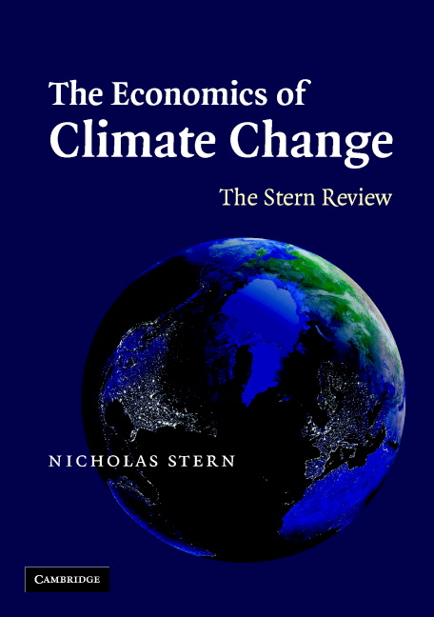
The Stern review (2006)
Assessment of the alarming impacts from climate change:
Temperature could rise over 5ºC
Impacts from global warming will be 5-20% of GDP
Costs of stabilizing greenhouse gas concentration at 550ppm of around 1% of GDP
Even with climate policy («act now»), global warming of more than two degrees likely
Notes:
2006: UK government releases a report: The Economics of Climate Change: The Stern Review, lead by Sir Nicholas Stern (Nobel Laureate)
SR estimates of costs of global warming are substantially higher than earlier estimates
Used similar data and methodology (IAM)
Review summary:
Unabated, climate change could result in an annual 5-20% decline in global output by 2100.
Comparison: US great depression – 1929-1930 real GDP fell by 9%
Costs to mitigate are around 1% of GDP
Policies for strong GHG reductions should be implemented immediately.
Why did the SR come to such a starkly different conclusion than the ramp?
Discounting (lower discount rate)
Damages (higher damages)

Slide 4
The Stern review (2006)
Anthropogenic climate change…
➔ … is the “biggest market failure the world has ever seen” (Stern)
Climate change externalities:
Costs/damages from emission of one ton of CO2 is not paid for.
Innovations (e.g., green technologies) receive less benefits than the society
Notes:
The social cost of GHGs is currently included in the economic calculation of firms.
Non-Excludability: Excludability is needed to ‘price-tag’ a good
We have to be able (or it has to be practical) to deny the consumption if price is not paid
Is «Climate Quality» excludable?
Non-Rivalry: An additional consumer can enjoy the good at no extra cost of provision.
Is «Climate Quality» rival? what about «Clean atmosphere»?
In theory “markets” provide an “optimal” (welfare or utility maximising) allocation of resources on the base on “scarcity” signals offered by prices.

Slide 5

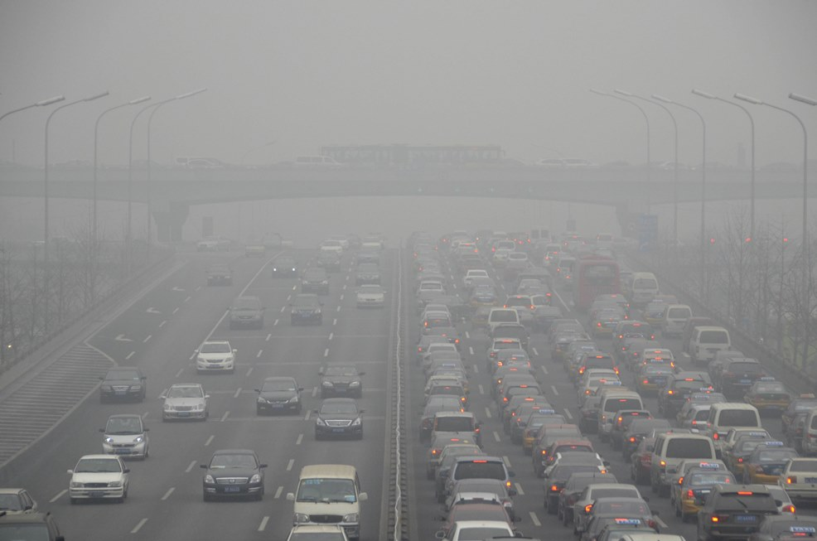
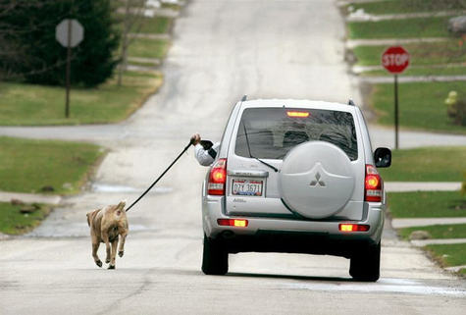

Excursus: Externalities (from Econ 101)
Externality: «your decisions affect the welfare of others»
«value»
value of consumption
=demand
Optimal
Social cost
damages/
«social costs»
price
gasoline
consumption
optimal
level
market
outcome

Slide 6
The Stern review (2006)
Find the right „price“ of emissions
„Social Cost of Carbon“ (SCC)
(social cost of the emission of one ton of CO₂)
Previous estimates: ~10$/tCO₂
Stern review: 85$/tCO₂
Notes:
The social cost of GHGs is currently included in the economic calculation of firms.
Non-Excludability: Excludability is needed to ‘price-tag’ a good
We have to be able (or it has to be practical) to deny the consumption if price is not paid
Is «Climate Quality» excludable?
Non-Rivalry: An additional consumer can enjoy the good at no extra cost of provision.
Is «Climate Quality» rival? what about «Clean atmosphere»?

Slide 7
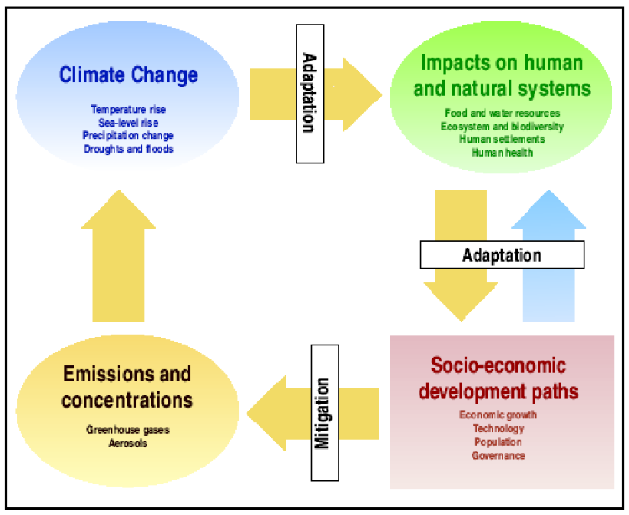
Climate Change – a complex system
Source: IPCC (2001)

Slide 8
Outline of the lecture
Outline
The Stern Review and the SCC
Economic impacts from Climate Change
Mitigation and Adaptation
Policy Instruments
Climate and Energy Policy

Slide 9
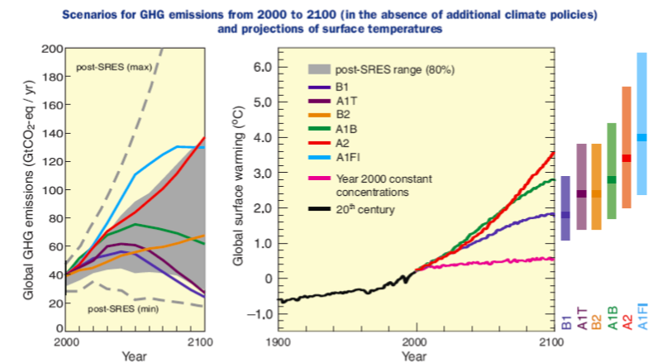
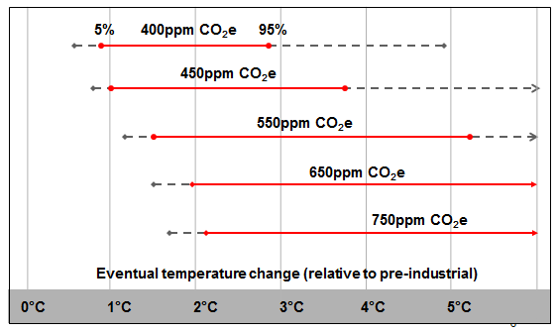
Impacts from Climate Change – Emissions and Temperature

Slide 10
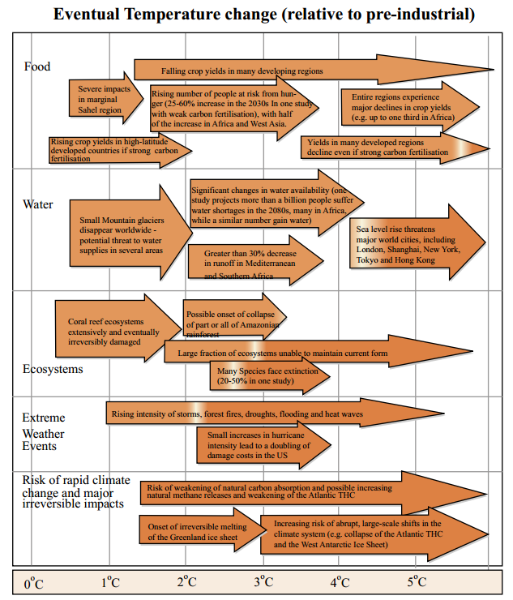
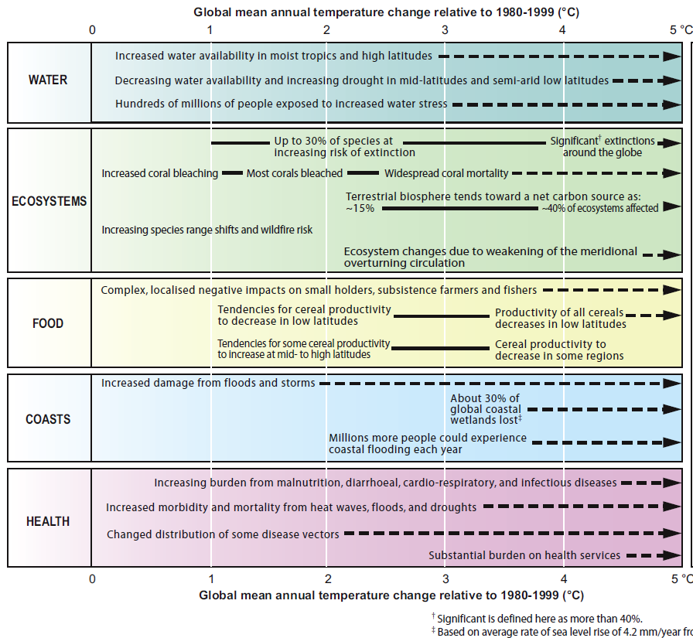
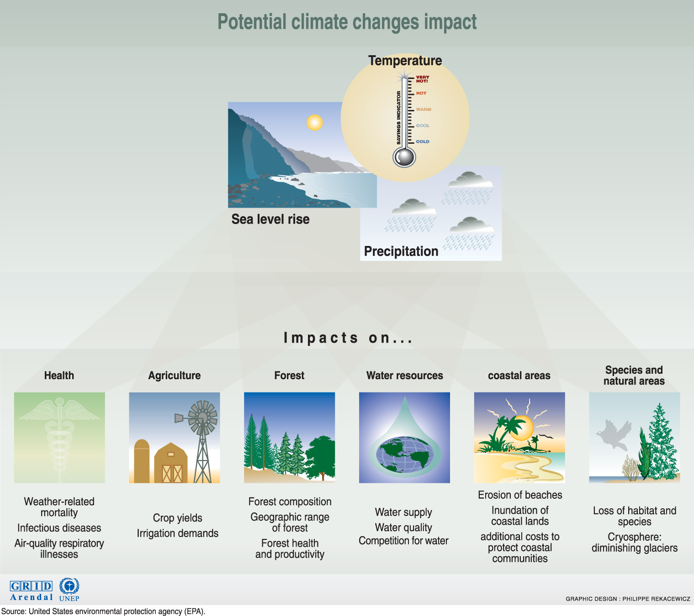
Impacts from Climate Change - Damages
Adapted from Stern (2007)
IPCC (2007)

Slide 11
Impacts from Climate Change – Evaluation of Damages
But how to evaluate impacts from climate change that…
affect future generations
affect different countries and regions
are highly uncertain and potentially irreversible
Standard Tool:
Integrated Assessment Models (IAMs)
to quantify costs and benefits
➔ Ethical foundations crucial!

Slide 12
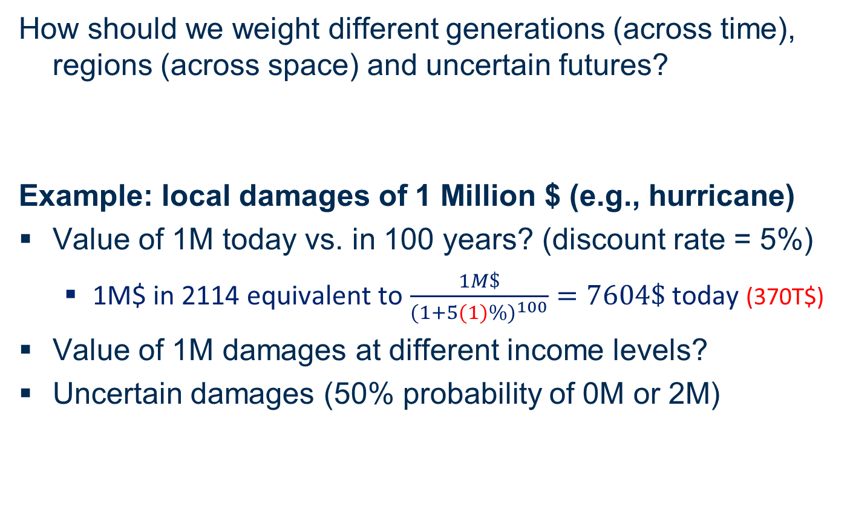
Impacts from Climate Change – Evaluation of Damages
How should we weight different generations (across time), regions (across space) and uncertain futures?
Example: local damages of 1 Million $ (e.g., hurricane)
Value of 1M today vs. in 100 years? (discount rate = 5%)
  1M$ in 2114 equivalent to $\frac{1M\$}{{(1+5(1)\%)}^{100}}=7604\$$ today (370T$)
Value of 1M damages at different income levels?
Uncertain damages (50% probability of 0M or 2M)
Notes:
Nordhaus (1997), "Discounting in Economics and Climate Change“
Reasons to discount:
Pure rate of time preference (time discounting)
rather consume today than later
Which weight to put on later generations (?)
Hard to defend a positive rate of time preference on ethical grounds
However, social decision processes often in favor of today’s generations
Economic growth (growth discounting)
If someone is richer in ten years, a dollar today might be worth more than a dollar in ten years (utility u(x) concave; x=consumption)
Future Growth will probably increase the standard of living
One might perceive it appropriate that later, richer generations pay a larger fraction of costs
The Productivity of Capital
$1 invested now will be worth $1 plus the rate of interest
How to choose the discount rate?

Slide 13
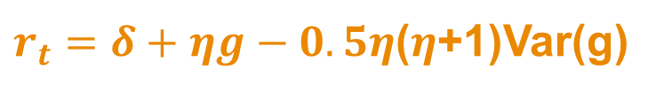

Impacts from Climate Change – Evaluation of Damages
Intergenerational equity:
The discussion about the discount rate
The discount rate - reasons to discount the future:
“impatience”/preference of the present (+/0)
  ➔ also true for generations (altruism/bequest motives)?
Possibility of extinction (+)
Growth effect: future generations are wealthier (+)
Uncertainty effect: but growth is uncertain (-)
$r_{t}=δ+ηg−0.5η$($η$+1)Var(g)
$$1.4\%=0.1\%+1∙1.3\%+0$$
Stern (2006)
Notes:
Nordhaus (1997), "Discounting in Economics and Climate Change“
Reasons to discount:
Pure rate of time preference (time discounting)
rather consume today than later
Which weight to put on later generations (?)
Hard to defend a positive rate of time preference on ethical grounds
However, social decision processes often in favor of today’s generations
Economic growth (growth discounting)
If someone is richer in ten years, a dollar today might be worth more than a dollar in ten years (utility u(x) concave; x=consumption)
Future Growth will probably increase the standard of living
One might perceive it appropriate that later, richer generations pay a larger fraction of costs
The Productivity of Capital
$1 invested now will be worth $1 plus the rate of interest
How to choose the discount rate?

Slide 14
Outline of the lecture
Outline
The Stern Review and the SCC
Economic impacts from Climate Change
Mitigation and Adaptation
Policy Instruments
Climate and Energy Policy

Slide 15
Mitigation and Adaptation – how to avoid/reduce impacts?
Mitigation
  Strategies for reducing the rate of climate change
  Abatement costs: costs of reducing emissions
  (mainly from fossil fuels & deforestation)
Adaptation
  Strategies for coping with climate change
  (mainly temperature changes and sea-level rise)
  Reducing future impacts

Slide 16
Mitigation and Adaptation - Mitigation Examples
Reduction of greenhouse-gas emissions
  Probably the most effective way
Using alternative energy sources, e.g., solar, wind, nuclear
  (France: 80% of power generation is nuclear)
Increase efficiency
  Improved gas mileage in cars
  Compact fluorescents light bulbs
Carbon capture and storage
  Send emissions into ground or deep ocean
Geoengineering
  Reduce incoming solar radiation
  (e.g., sulfur in stratosphere)

Slide 17
Mitigation and Adaptation – Abatement costs
Cost of abatement
EUR/tCO₂e
Industrial
feedstock substitution
Coal-to-
gas shift
Avoid
deforestation
Asia
CCS; coal
retrofit
Livestock/
soils
Forestation
Soil
Waste
40
CCS EOR;
New coal
Wind;
low
pen.
Smart transit
Solar
30
Small hydro
Nuclear
Forestation
20
Industrial non-CO₂
10
Airplane efficiency
0
Stand-by losses
-10
0
1
2
3
4
5
6
7
8
9
10
11
12
13
14
15
16
17
18
19
20
21
22
23
24
25
26
27
  Gton CO₂e
-20
Cellulose
ethanol
Avoided
deforestation
America
Industrial
CCS
-30
Industrial
non-CO₂
-40
Sugarcane
biofuel
Co-firing
biomass
CCS;
new coal
Abatement
GtCO₂e/year
-50
-60
Fuel efficient vehicles
Industrial motor
systems
-70
Water heating
-80
-90
Air Conditioning
-100
Lighting systems
-110
Fuel efficient commercial vehicles
-120
-130
McKinsey (2009)
-140
-150
Insulation improvements
-160

Slide 18
Mitigation and Adaptation – Adaptation Examples
Sea-level rise
  Build coastal defenses
  (e.g., dikes, as in the Netherlands)
  Relocation of affected populations
  (Millions of refugees possible)
Agriculture
  Increased use of irrigation
  Development of heat- and drought-resistance crops
Human health and comfort
  Increased use of air conditioning

Slide 19
Outline of the lecture
Outline
The Stern Review and the SCC
Economic impacts from Climate Change
Mitigation and Adaptation
Policy Instruments
Climate and Energy Policy

Slide 20
Policy Instruments
How to achieve climate action (mitigation)?
(➔ externality issue)
Instruments:
Command-and-Control
Cap-and-trade system (market-based)
Carbon tax (market-based)
R&D subsidies

Slide 21
Policy Instruments
Cap-and-trade System
A cap is defined, issuance of permits to emit up to the cap
Polluters are given/auctioned off emission permits
To exceed emission limit, a company may buy permits from polluters that emit less than their permits
Successful examples e.g. for SO₂
Quantity of emissions fixed
Market price for emissions p$/tCO₂
Carbon tax
All Polluters need to pay a fixed tax of x$/tCO₂ per ton emitted
Increases government revenues (double dividend, e.g., reduce labour taxes)
Should apply to all sources of emissions
Price of emissions fixed at x$/tCO₂
Quantity depends on re-action of firms/consumers
Notes:
Auction: government sells permits to the highest bidders (generates revenue).
Give away: government hands out permits for free (who gets the handout and who doesn’t?)
Reality: likely a combination of both, transitioning to predominantly auction over time.
E.g. Waxman-Markey (2009): 85% of permits given away to industry, remainder auctioned (free permits phased out over time)
http://marginalrevolution.com/marginalrevolution/2011/09/do-all-serious-economists-favor-a-carbon-tax.html
Tyler Cowen on September 18, 2011
Do all serious economists favor a carbon tax?
by Tyler Cowen on September 18, 2011 at 7:45 am in Economics | Permalink
Richard Thaler, Justin Wolfers, and Alex all consider that question on Twitter. I say no. While I personally favor such a policy, here are my reservations:
….
It seems to me entirely possible that a serious economist would find those arguments hold the balance of power. In my view those points stack up against a) the problem seems to be worse than we thought at first, b) the philosophic “we are truly obliged to do something,” and c) “some taxes need to go up anyway” arguments.
I am in any case not an optimist on the issue and I consider my pessimism a more fundamental description of my views on the issue than any policy recommendation. If you study tech, you will see a bright present and also a bright future. If you study K-12 education, you will see a mixed to dismal present and a possibly bright future. If you study energy economics and the environment, you will see an OK present and a dismal future, no matter what policies we choose.

Slide 22
Policy Instruments
Market based instruments
cost-effective
«prices» CO₂ emissions adequately
(equalizes marginal costs of abatement)
firms and households will internalize the externality
What should be the right permit price / carbon tax?
➔ Equal to the Social Cost of Carbon (SCC)
(~10-85$/tCO₂e, see before)

Slide 23
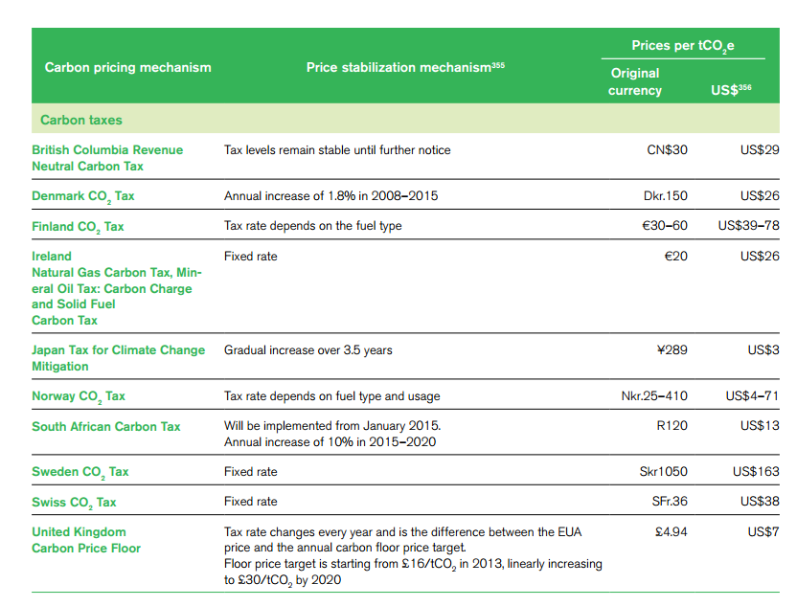
Policy Instruments – Examples of Carbon Taxes
Source: The World Bank (2013, p.82)

Slide 24
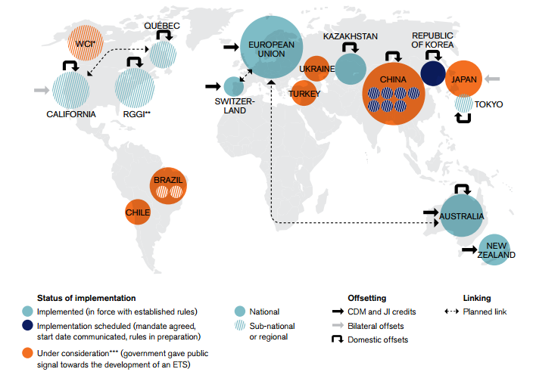
Policy Instruments – Examples of Emission Trading Schemes
The World Bank (2013)
cover around 20% of global GHG emissions
Notes:
«Mapping Carbon Pricing Initiatives»
http://www-wds.worldbank.org/external/default/WDSContentServer/WDSP/IB/2013/05/23/000350881_20130523172114/Rendered/PDF/779550WP0Mappi0til050290130morning0.pdf

Slide 25
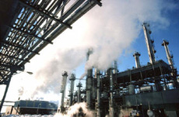
Policy Instruments – The EU ETS
EU ETS:
Covers more than 11,000 installations
in 31 countries (~45% of the EU’s
greenhouse gas emissions)
Sectors: power and heat generation, energy-intensive industries, civil aviation
Launched in 2005, various phases
Cap was set to for 2020 to reach a 21% reduction of greenhouse gas emissions (EU Kyoto target) compared to 1990

Slide 26
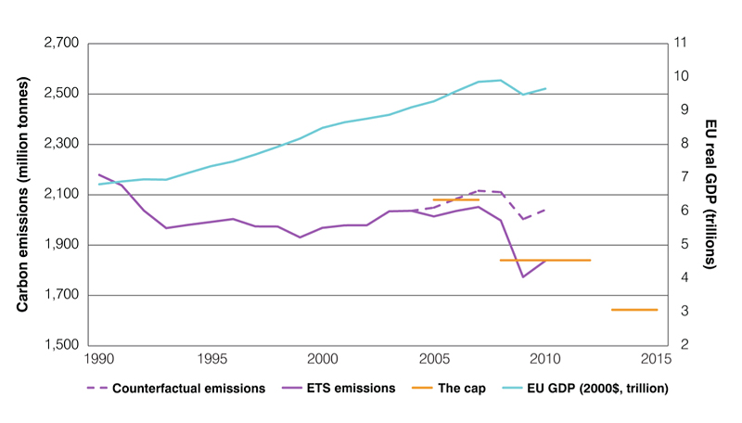
Policy Instruments – The EU ETS

Slide 27
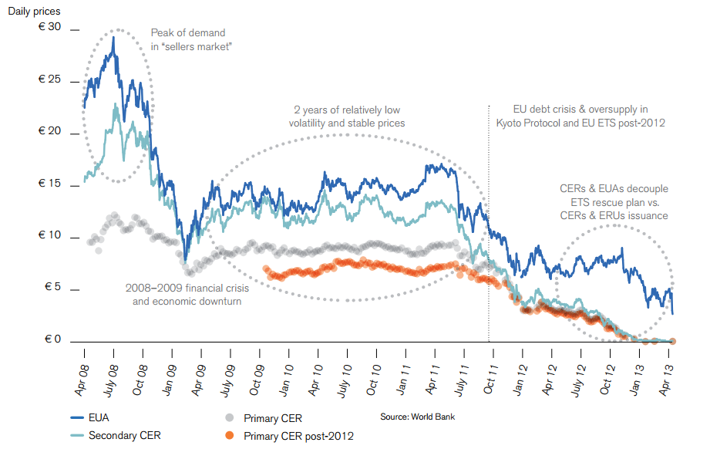

Policy Instruments – The EU ETS
~3€!
Source: The World Bank (2013, p.41)

Slide 28
Outline of the lecture
Outline
The Stern Review and the SCC
Economic impacts from Climate Change
Mitigation and Adaptation
Policy Instruments
Climate and Energy Policy

Slide 29
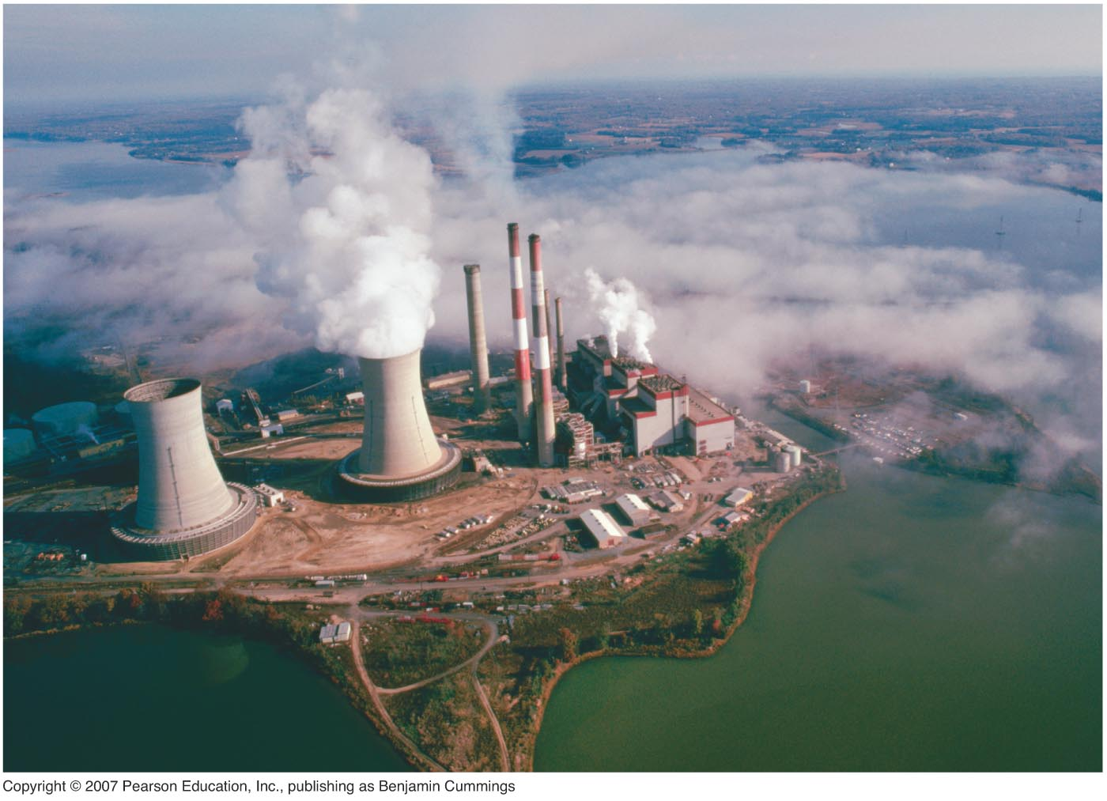
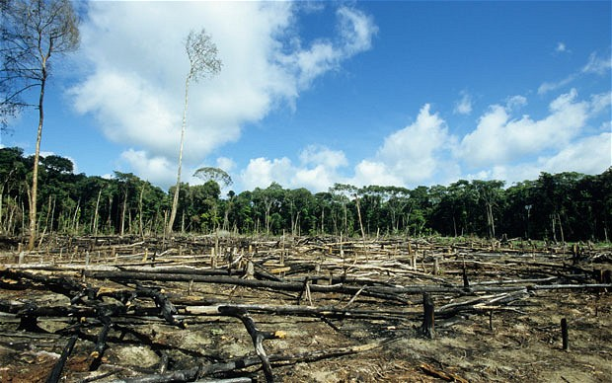
Climate and Energy Policy – The Role of Energy
CO₂ emissions increase due mainly to:
Burning of fossil fuels: We remove and combust carbon-rich fuels from the ground where they have been stored for millions of years, sending CO₂ into the atmosphere.
Deforestation: Cutting down trees, removing vegetation from the land, decreases the sink for carbon.

Slide 30
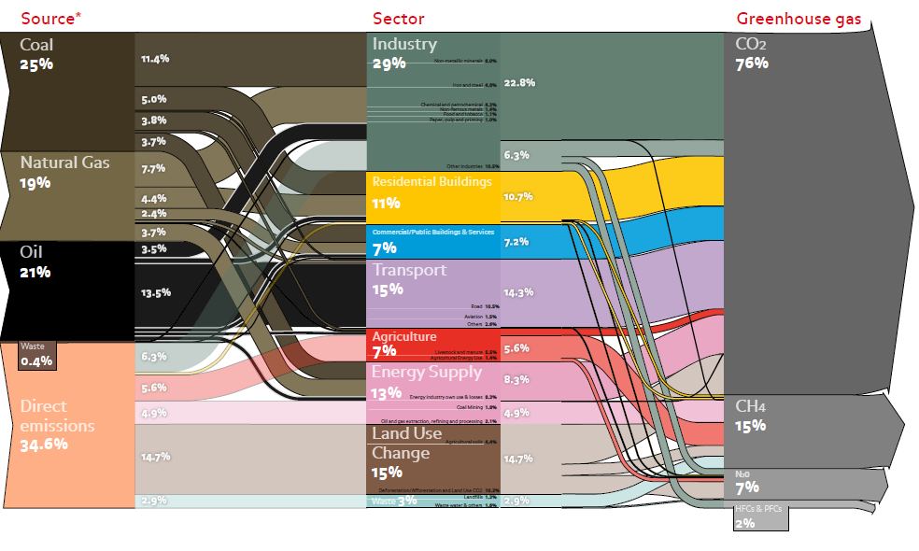
Climate and Energy Policy – The Role of Energy
Total GHG emissions 2010: (~47GtCo2e)
Notes:
http://www.ecofys.com/files/files/asn-ecofys-2013-world-ghg-emissions-flow-chart-2010.pdf
ECOFYS (2012)

Slide 31
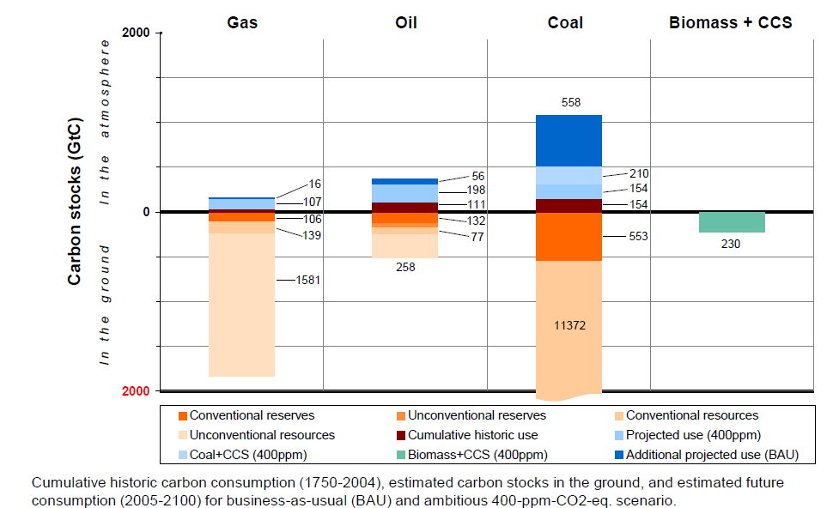
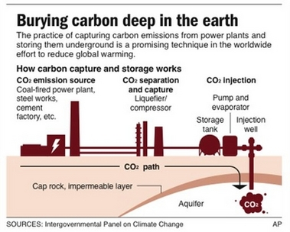
Climate and Energy Policy – Carbon Stocks
Kalkuhl, Edenhofer and Lessmann (2009)

Slide 32
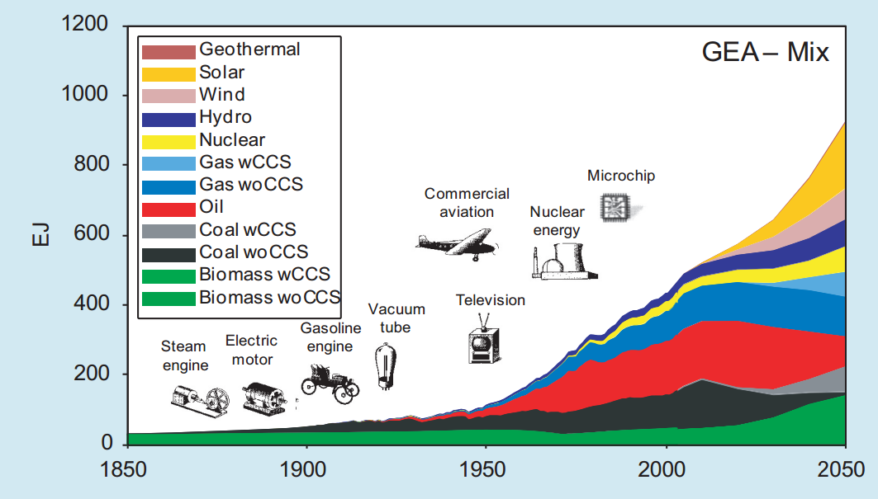
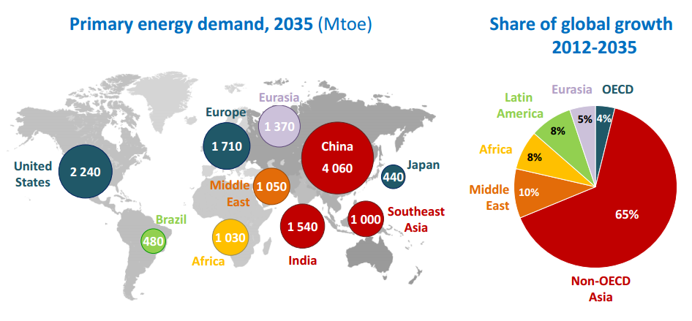
Climate and Energy Policy – Energy Sources
Source: IEA (2013)

Slide 33
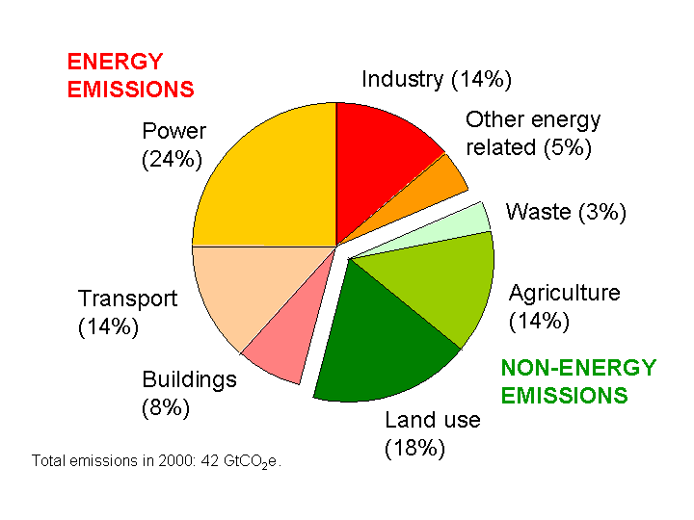
Climate and Energy Policy – The Role of Energy
Energy emissions account for around 2/3 of total emissions

Slide 34
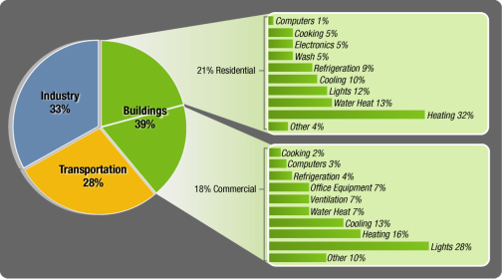
Climate and Energy Policy – Energy Solutions
Energy Efficiency Improvements (Reduce emissions per unit of output) ➔ reduces energy demand
Transforming the transport sector (electric, biofuels, …)
Decarbonizing the power sector
U.S. Energy Consumption
(2009, EIA)

Slide 35
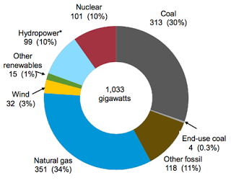
Climate and Energy Policy – Energy Solutions for Electricity
Sources for installed electricity generating power 2009 (Newell EIA 2011 )

Slide 36
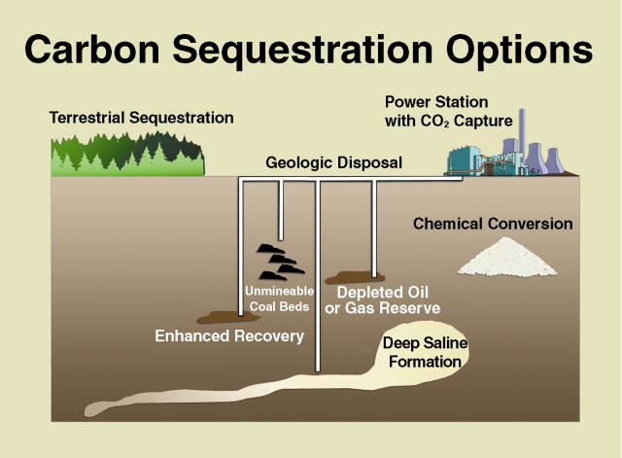
Climate and Energy Policy – Energy Solutions for Electricity
New generation of nuclear fission, and fusion
Renewable energy sources for Power generation
  Hydroelectric power
  Photovoltaics
  Wind power
  Geothermal energy
Carbon capture and storage (CCS) if feasible

Slide 37
Conclusions
Economic costs from climate change are important, and negative externalities
Evaluation involves important and problematic ethical issues
Mitigation and adaptation options are available
Policy instruments to overcome the externality and to induce mitigation are to „price“ carbon emissions
Transformation and decarbonisation of the energy system is the major challenge
(left out from here: collective action problem, see next weeks)

Slide 38
References
References:
Chapters by M.Sagoff and R.Mendelsohn from The Oxford Companion of Climate Change and Society (OCCCS), ed. by Dryzek, John et al., Oxford UP 2012, Parts 2,3 and 9
Stern Review on the Economics of Climate Change, 2006, www.hm-treasury.gov.uk/sternreview_index.html
Don Fullerton and Robert Stavins, 1998, “How Economists See the Environment,” Nature, 395:6701, pp. 433-434, at http://www.hks.harvard.edu/fs/rstavins/Papers/How%20Economists%20See%20The%20Environment.pdf
IPCC, 2007: Summary for Policymakers. In: Climate Change 2007: Mitigation. Contribution of Working Group III to the Fourth Assessment Report of the Intergovernmental Panel on Climate Change [B. Metz, O.R. Davidson, P.R. Bosch, R. Dave, L.A. Meyer (eds)], Cambridge University Press, Cambridge, United Kingdom and New York, NY, USA, at http://www.ipcc.ch/pdf/assessment-report/ar4/wg3/ar4-wg3-spm.pdf
IPCC, 2007: Summary for Policymakers. In: Climate Change 2007: Impacts, Adaptation and Vulnerability. Contribution of Working
Group II to the Fourth Assessment Report of the Intergovernmental Panel on Climate Change, M.L. Parry, O.F. Canziani, J.P. Palutikof, P.J. van der Linden and C.E. Hanson, Eds., Cambridge University Press, Cambridge, UK, 7-22, at http://www.ipcc.ch/pdf/assessment-report/ar4/wg2/ar4-wg2-spm.pdf
GEA, 2012: Global Energy Assessment – Toward a Sustainable Future, Cambridge University Press, Cambridge UK and New York, NY, USA and the International Institute for Applied Systems Analysis, Laxenburg, Austria.
The World Bank, 2013, Mapping Carbon Pricing Inititiatives, Washington D.C., available at http://www-wds.worldbank.org/external/default/WDSContentServer/WDSP/IB/2013/05/23/000350881_20130523172114/Rendered/PDF/779550WP0Mappi0til050290130morning0.pdf
McKinsey and Company, 2009, Pathways to a Low-Carbon Economy: Version 2 of the Global Greenhouse Gas Abatement Cost Curve, available at https://solutions.mckinsey.com/climatedesk/default.aspx

Slide 39
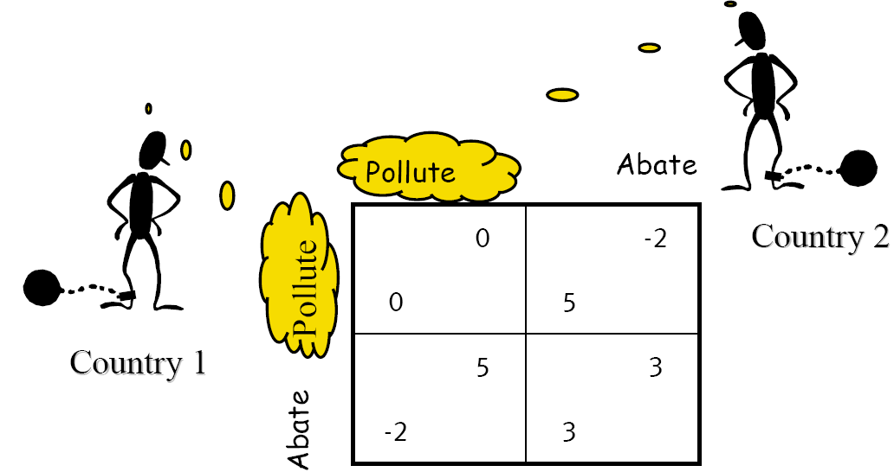
Climate policy as collective action problem
Cost of inaction: 5 – 20 % of global GDP/year
Cost of action (550ppmv): 1 % of global GDP/year
But: Self-interest impedes cooperation (prisoner’s dilemma)!

